Slide 1


Image Feature Detection & Count Using Computer Vision
MS Data Science & Business Analytics
DSA/DSB/DSE 7500 - Summer 2020
Practicum Project Final Presentation
08 August 2020
Notes:
Karim:
1- Resizing of the title

Slide 2
Agenda
Introduction
Team
Faculty
Sponsor
Project Details
Project Objective
Project Deliverables
Deployable Features
Business Value
Technical Details
Techniques Researched
Implemented Technique
Template Matching - Process Flow
Testing & Results
Demo Videos
Limitations & Recommendations
Future Scope
Lessons Learned
Notes:
Karim
- Briefly go through this section

Slide 3
Introduction

Slide 4





Team
Kamrun Sumi
Karim Alhusaini
Mathai Paul
Matt Seraj
Rajpal Virk
MSDSBA Advanced Analytics
MSDSBA Advanced Analytics
MSDSBA Advanced Analytics
MSDSBA Data Driven Business
MSDSBA Advanced Analytics
Notes:
Karim
1- Resized some of the images
2- Added concentration

Slide 5


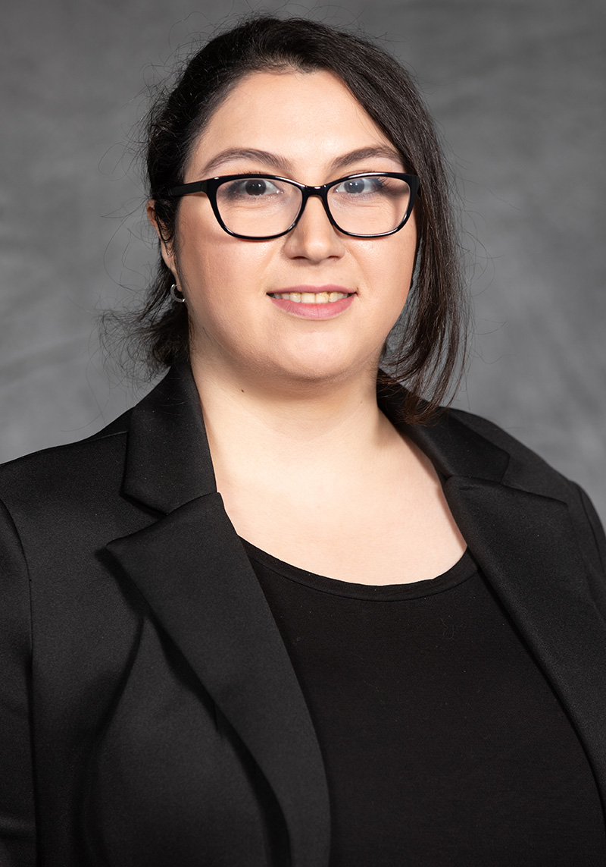
Faculty
Dr. Yanchao Liu
Assistant Professor
Dr. Murat Yildirim
Assistant Professor
Dr. Sara Masoud
Assistant Professor
Notes:
Karim
1- Resized prof titles

Slide 6


Sponsor
Ben Messick
Stan Patterson
Corporate Strategy Deployment Manager
VP of Operations
Notes:
Karim
1- Resize title

Slide 7
Project Details

Slide 8
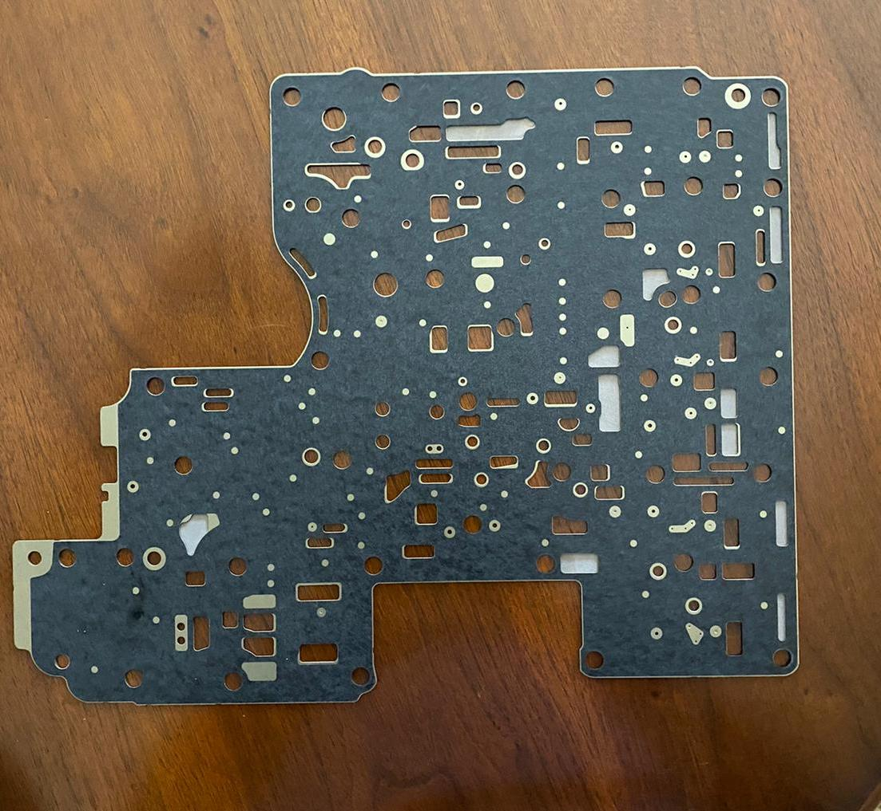
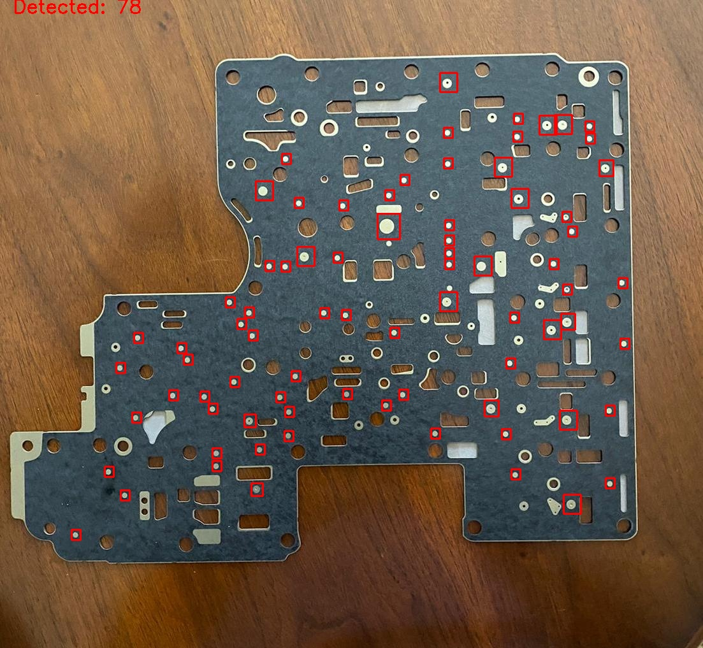
Project Objective
Use machine learning to identify and count the instance(s) of a certain feature present in the object image
Feature
Input Image
Output Image
Notes:
Karim
The main ask of the project is to use machine learning to identify and count the instances of a certain feature within an object image.
Feature can be a defect, component or else.

Slide 9



Project Deliverables
Python script that takes a set of 2 images (source image and feature image) as input and results in the correct count of a certain feature as output
Literature review and documentation related to Python code application
Deployable Features
Based on open-source libraries:
Notes:
Karim
Based on the objective, we were tasked with two tasks:
1- Python script
2- Documentation
The code deliverable had to meet certain criteria, the first being…..
The script deliverable also needed to meet a few criteria

Slide 10
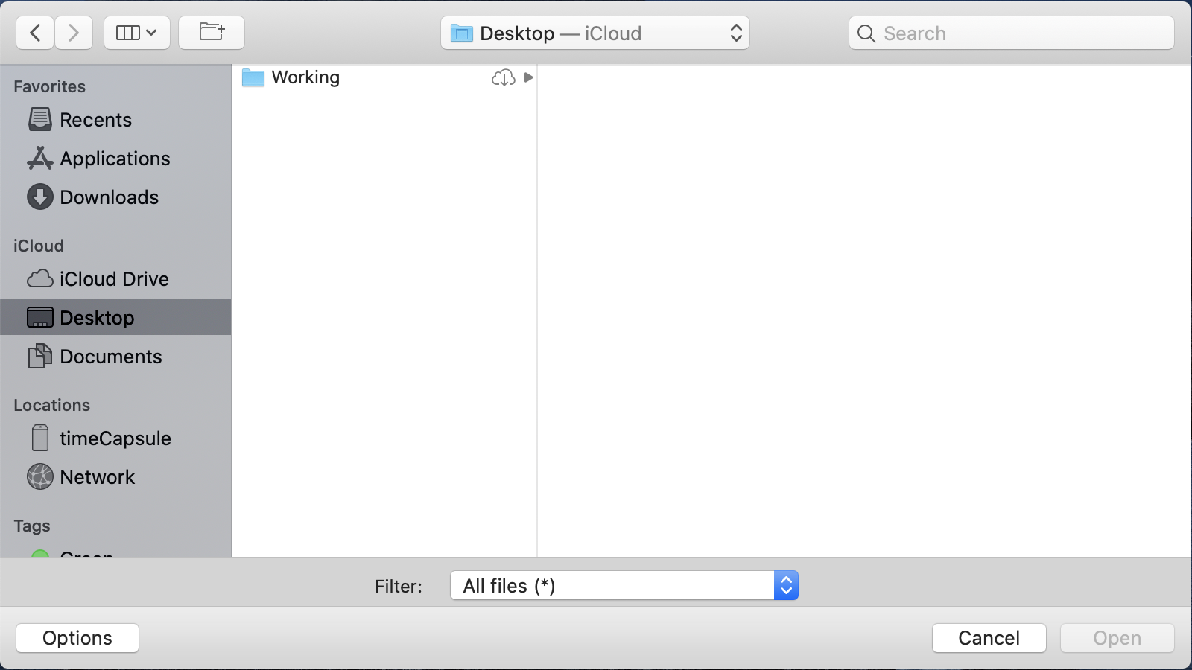


Deployable Features (cont’d)
Support for GUI:
Highly Dynamic:
Works on any given part and detects any selected feature
Highly portable:
Cross-platform compatibility with different operating systems, primarily Android
Notes:
Support for GUI:
It needed to be user friendly, easily navigable.
Most importantly, it needed to be highly dynamic, meaning it works on any given provide, and detects any selected feature. Finally, it need to be compatible with multiple platforms, mainly Android.

Slide 11
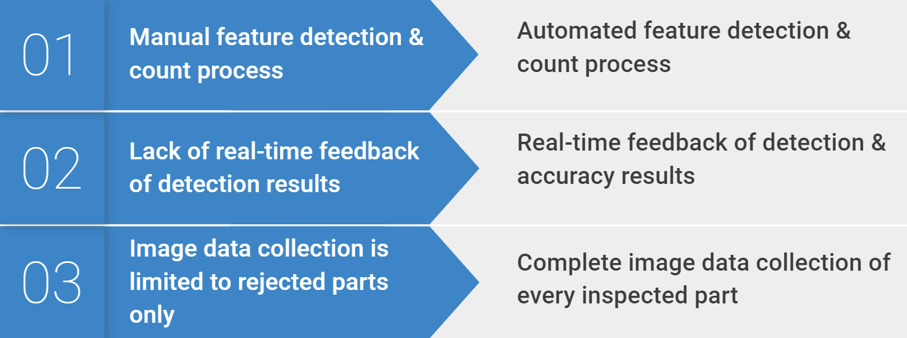
Business Value
Process improvement & proof of concept project
Current Process
Proposed Process
Notes:
Karim
There value and vision of this project is:
1- Process improvement: increase accuracy, improve efficiency, reduce cost
2- Proof of concept to demonstrate if the idea works, and it can be refined later

Slide 12
Technical Details

Slide 13

Techniques Researched
YOLO Object Detection
Method: Fast and real-time object detection using pre-trained models
Limitation: Lack of optimized pre-trained models for most industrial parts
Notes:
Based on the deliverables, we researched a few methods. Some of the methods we considered and tested include:

Slide 14
Techniques Researched (cont’d)
HSV Color Space & BLOB Detection
Method: Feature detection and count using HSV color parameters and BLOB detection
Limitation: Sensitive to color variations and requires manual parameter tuning
One-shot Learning
Method: Learns information about object categories with one or a few training images
Limitations: Slow training process and no single model generalizes well on all parts

Slide 15
Technique Implemented
Template Matching
Pixel to pixel match between a template image (feature) and a source image (part)
Dynamic – No time-consuming model training required for different parts. Instead, a single algorithm generalizes well
Batch Processing – Single feature template can be used to process a large batch of part images
Minimum Operator Input – Key input requirement is feature template image to detect and count features in image data
Real-time Result Output – Images can be processed in as little as a few seconds
Integration – Integrates well as an extension to last year’s practicum project
Notes:
Karim
Ultimately, we decided to use Template Matching the MVP (primary) method for this project.
Template matching alone is very rigid, therefore, we added a few optional features to make it more flexible

Slide 16
Template Matching - Process Flow
Image Input
Pre-process Image
Template Selection
Template Matching
Result Output
Resize*
Warp*
Filter
Grayscale
Select New Template (OR)
Use Existing Template**
ROI selected using Template Matching based on user-input
Scale Image*
Rotate Image*
Threshold
* Optional Input parameters
** Use existing template for batch processing

Slide 17
Demo Videos

Slide 18
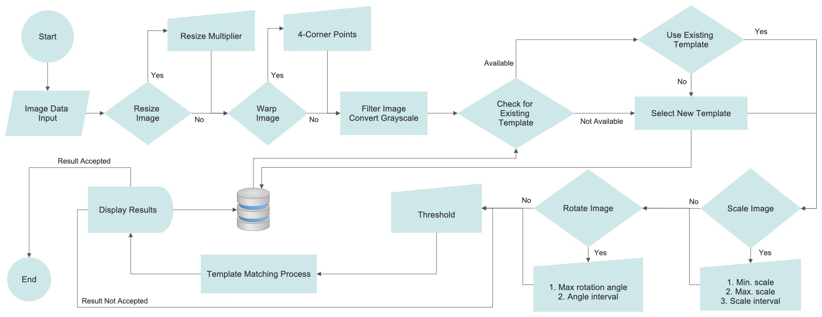
Template Matching - Process Flow
Notes:
Increase line thickness

Slide 19
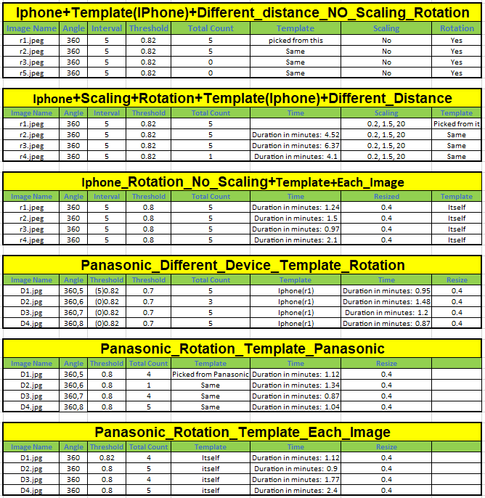
Testing & Results
Code tested on multiple images with different parameters
Parameters tested:
Image resolution
Camera distance
Camera angle
Lighting & visual obstructions
Notes:
Karim
-Added this slide to demonstrate testing. Story can be we’ve done testing and based on the results, we have come to understand the limitations. Based on our testing, noted a few limitations and proposed recommendations on how to overcome those.

Slide 20
Limitations & Recommendations

Slide 21
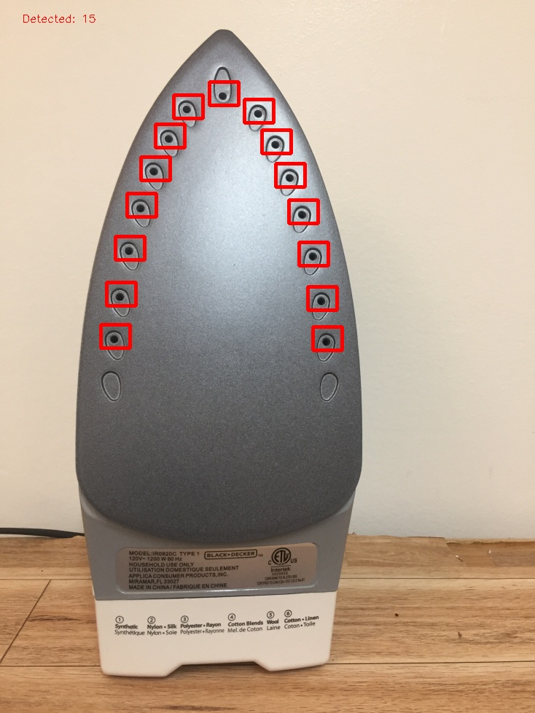
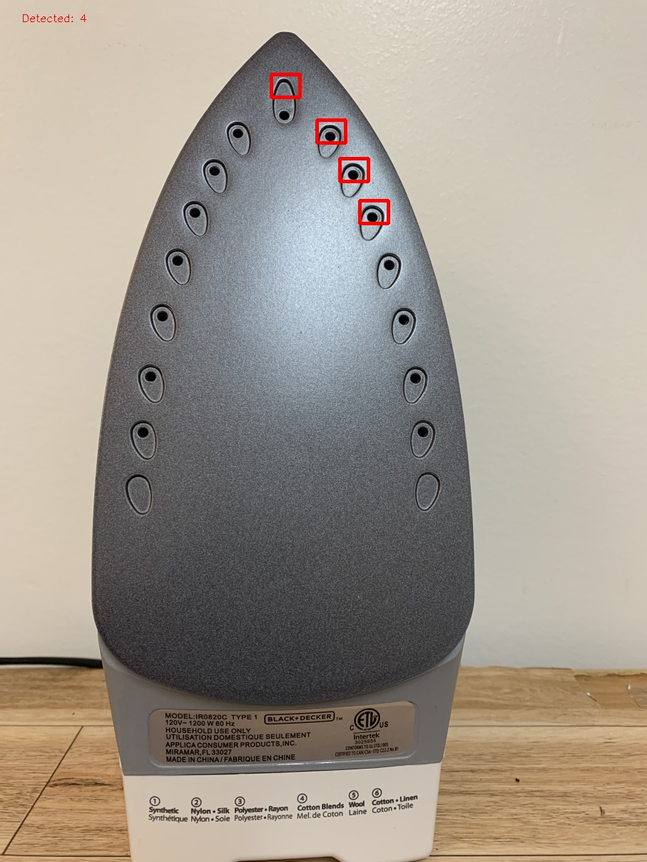
Image Resolution Variations
Limitation
In batch processing, using a high-resolution template image to process low resolution input data (or vice-versa) can decrease the detection accuracy
Low Resolution Template Image
High Resolution Input Image
Accuracy < 30%
Low Resolution Input Image
Accuracy > 90%
Notes:
Karim
-Wording changes
Need to add Gasket image (couldn’t find a suitable image)
- Need to reiterate that we’re considering each limitation individually, everything else held constant

Slide 22
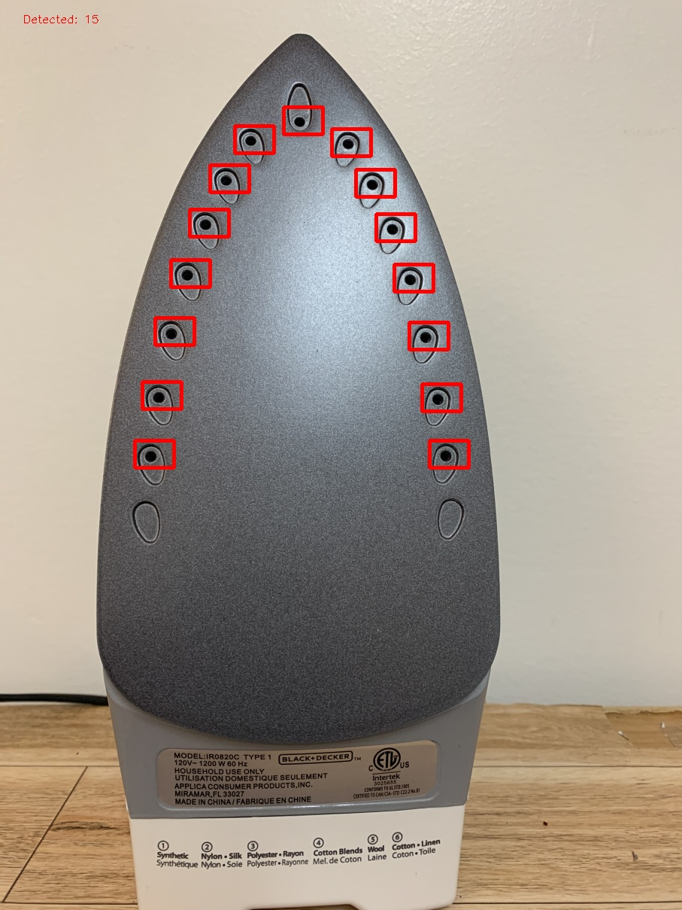

Image Resolution Variations
Recommendations
Select distinct new templates for both low-resolution and high-resolution batch image data
Low Resolution Template Image
High Resolution Template Image
Low Resolution Input Image
Accuracy > 90%
High Resolution Input Image
Accuracy > 90%
Alternatively, the user can adjust the threshold parameter to increase accuracy
Notes:
Threshold: how the strict the template matching algorithm has to be while processing the image

Slide 23
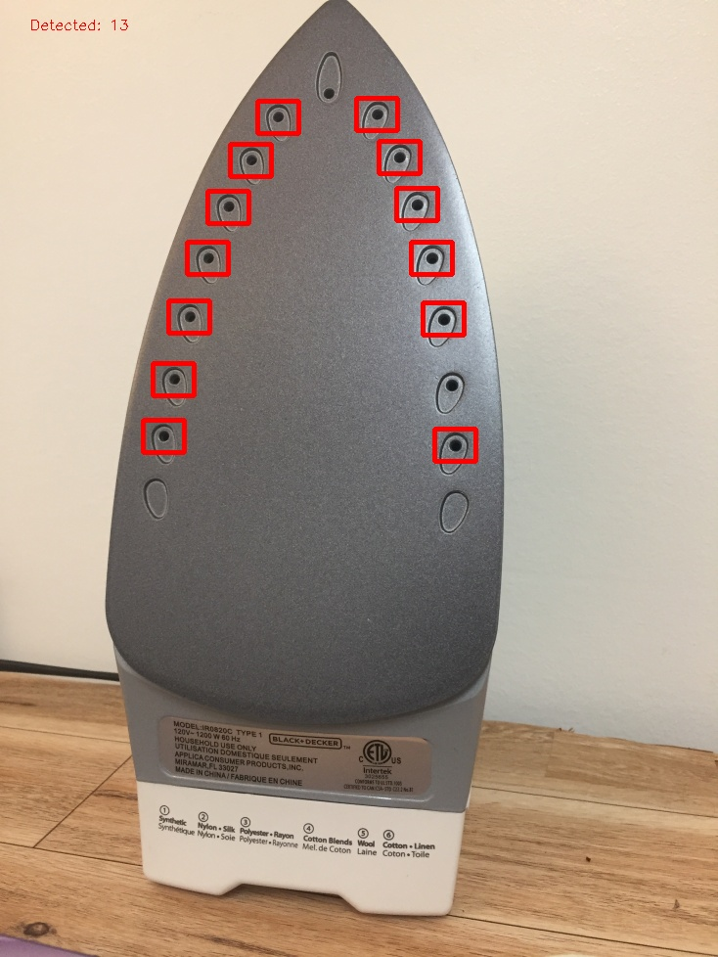
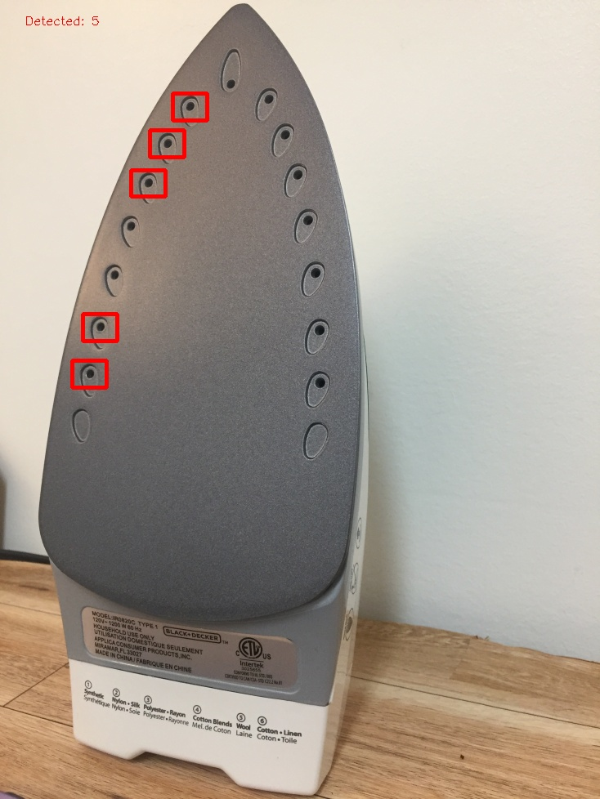
Camera Angle Variations
Limitation
Processing Images captured at different angles using a template taken from a certain fixed angle can decrease the detection accuracy
Template Selected from Straight Image
Straight Image
Accuracy > 90%
Angled-Image @ 15 degrees
Accuracy > 85%
Angled-Image @ 30 degrees
Accuracy < 50%

Slide 24
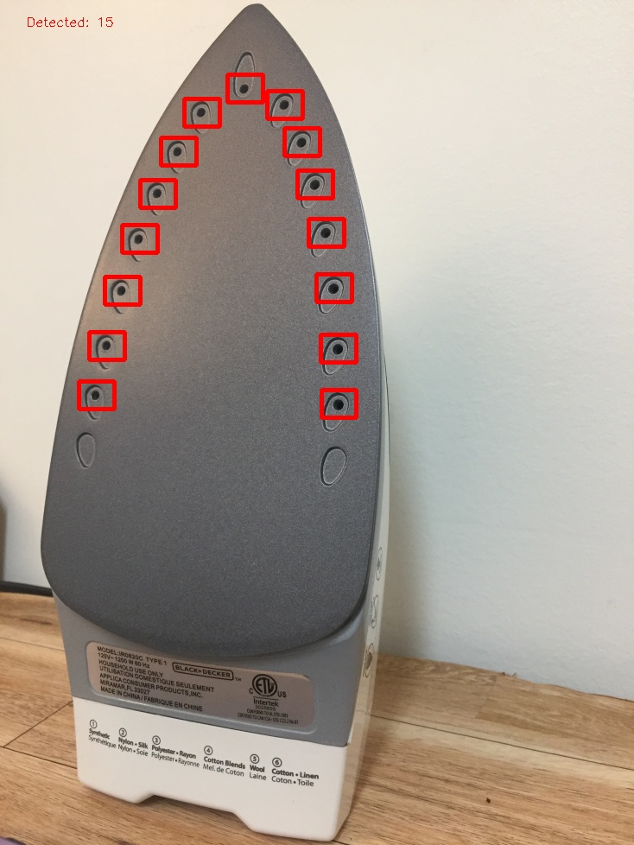
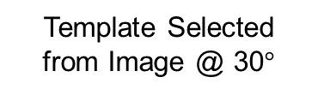


Camera Angle Variations
Recommendation
Use new templates for images rotated more than $±8°$
Template Selected from Straight Image
Template Selected from Image @ 30$°$
Straight Image
Accuracy > 90%
Angled-Image @ 3$0°$
Accuracy >90%
Alternatively, the user can adjust the rotation, warping and threshold parameters to increase accuracy
Notes:
The user can adjust the parameters, without having to select a new template.

Slide 25
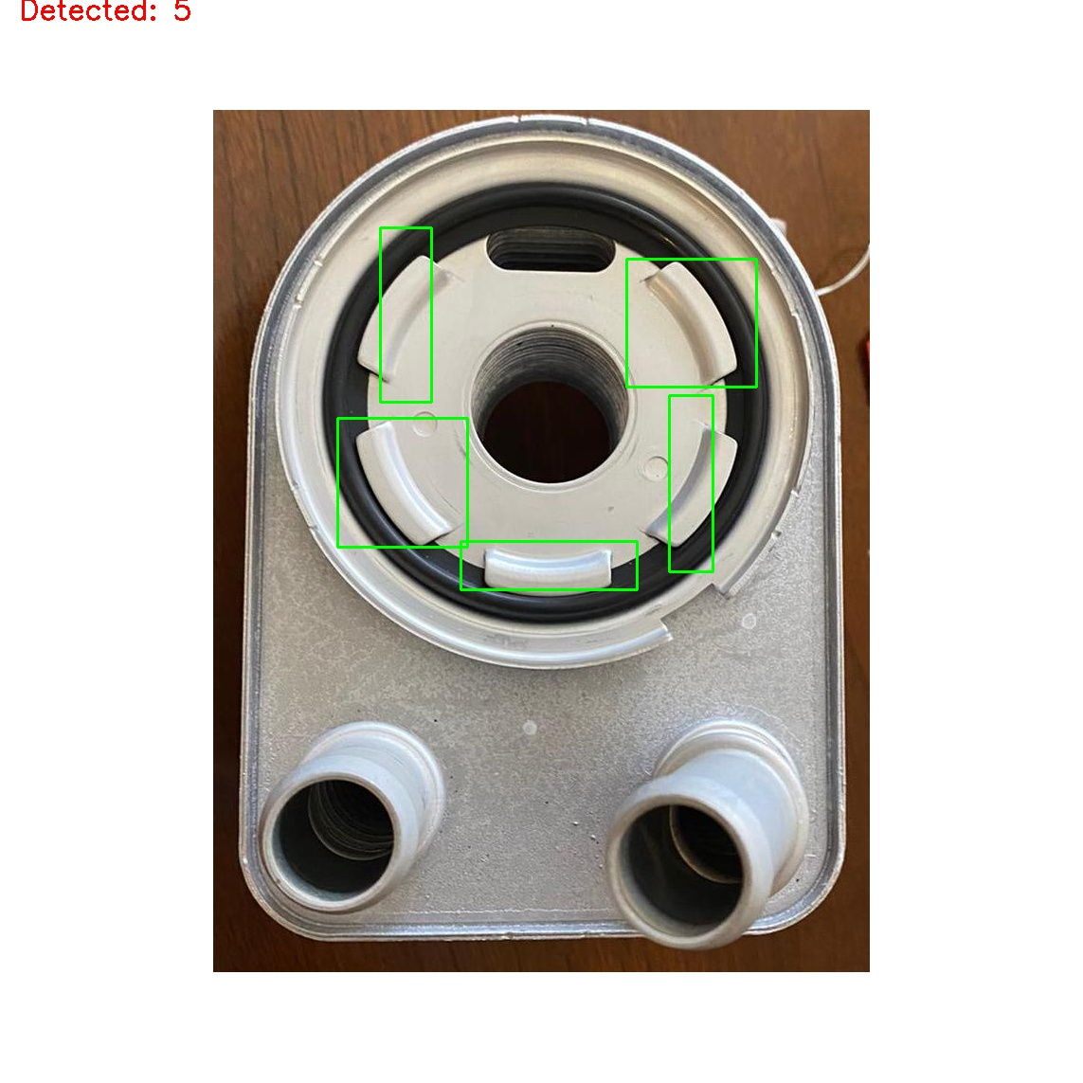
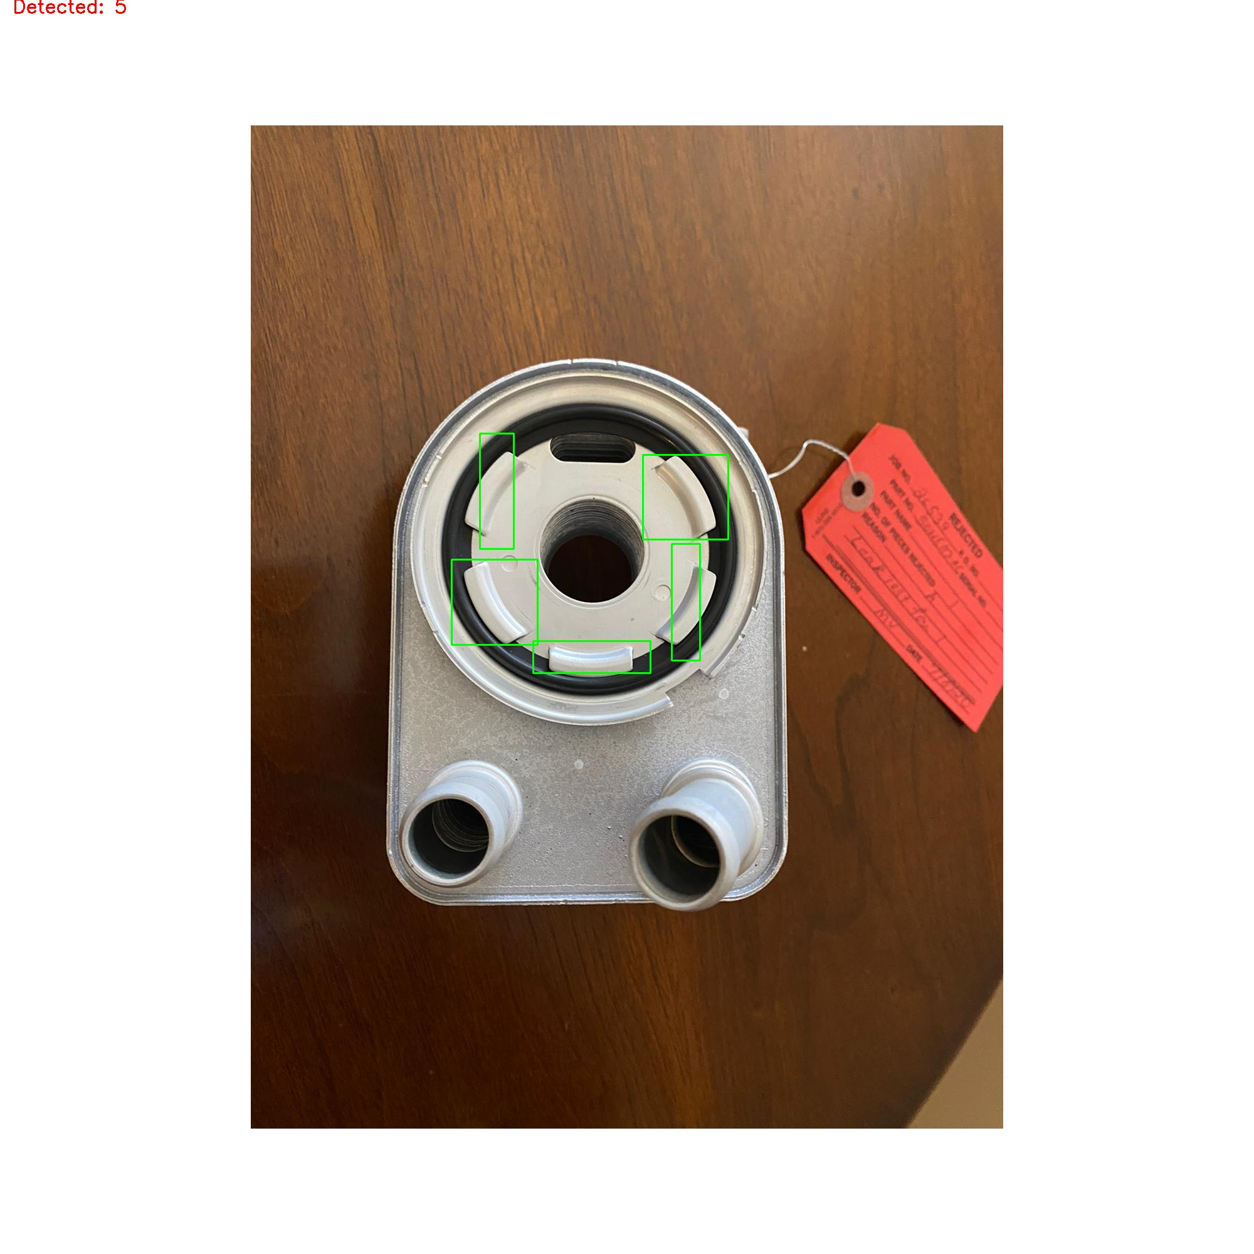
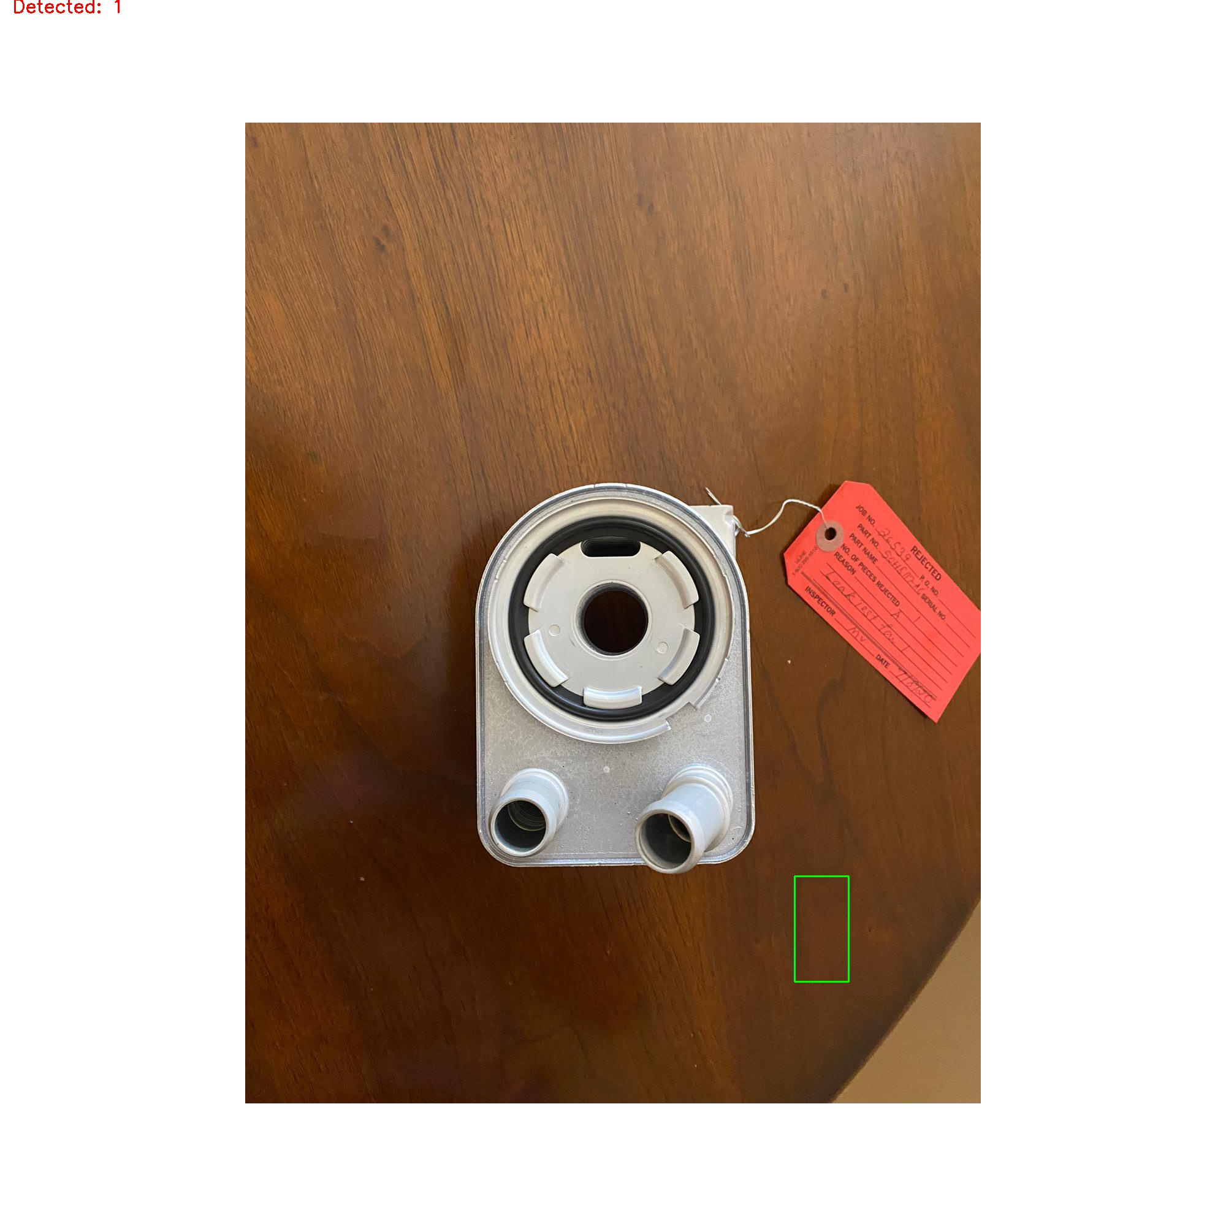

Camera Distance Variations
Limitation
Processing images captured at different distances using a template taken from a fixed distance can reduce detection accuracy
Template
Original source image: 1 ft away
>90% Accuracy
2ft away
>90% Accuracy
3ft away
<20% Accuracy
Notes:
Using ridge: with no parameter adjustment

Slide 26

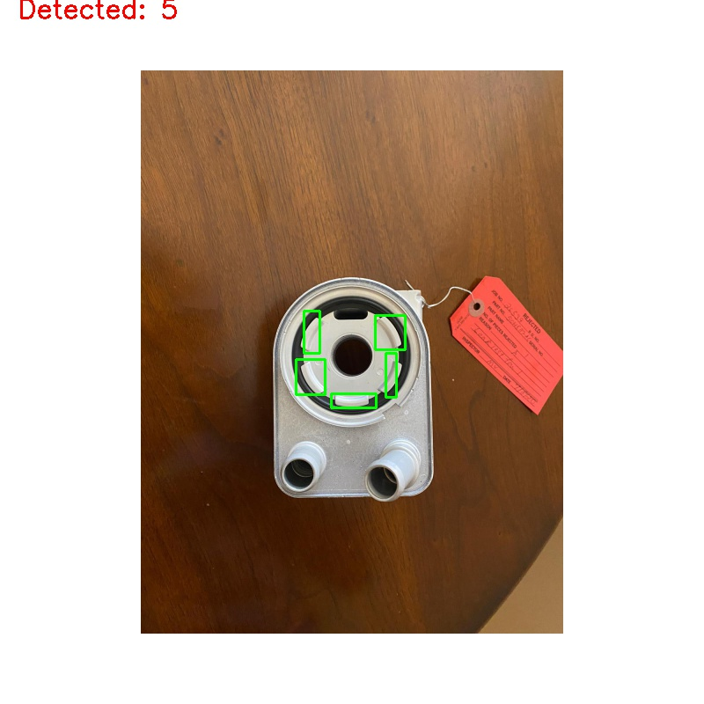
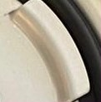

Camera Distance Variations
Recommendation
Select new templates for images at distances more than 1.25 times of original distance
Alternatively, the user can adjust the scaling and threshold parameters to increase accuracy
Template selected from image at 2ft distance
Template selected from image at 3ft distance
Image at 2ft distance
Accuracy > 90%
Image at 3ft distance
Accuracy > 90%

Slide 27
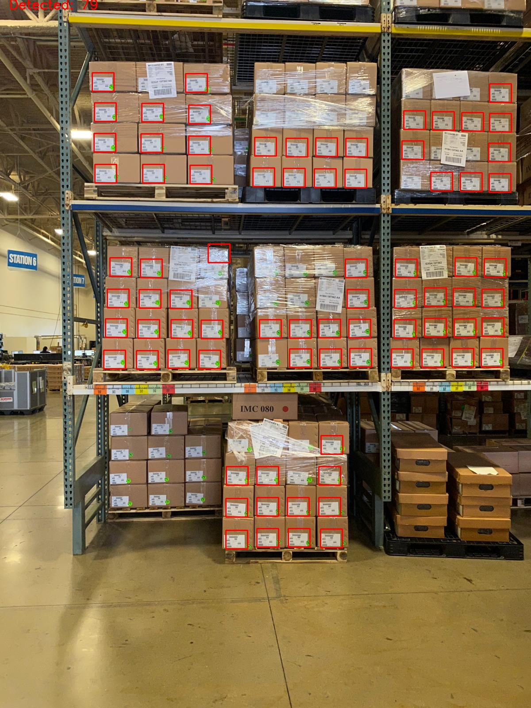
Lighting & Visual Obstructions
Limitation
Strong light reflections / illuminations and obstructions can result in poor accuracy
Light reflection ceased detection of objects
Labels hid features that match with template
Recommendation - Retake images without light reflection and obstructions

Slide 28
Future Scope

Slide 29
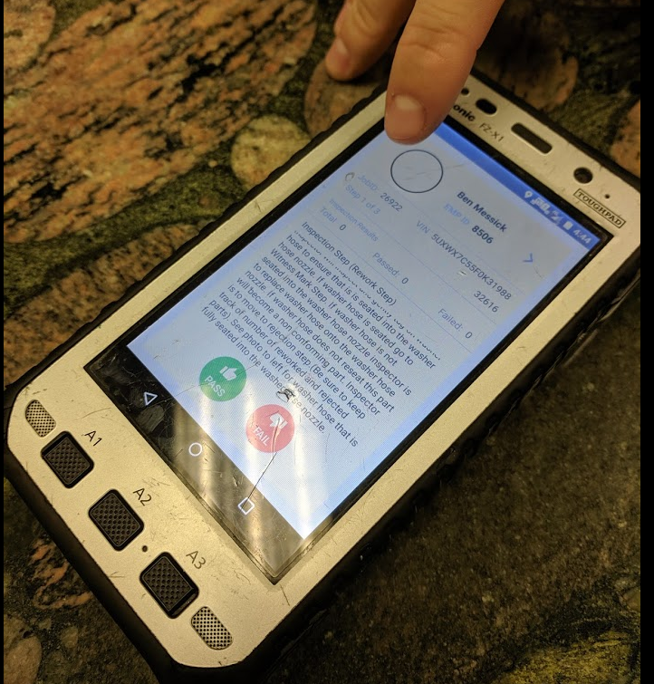
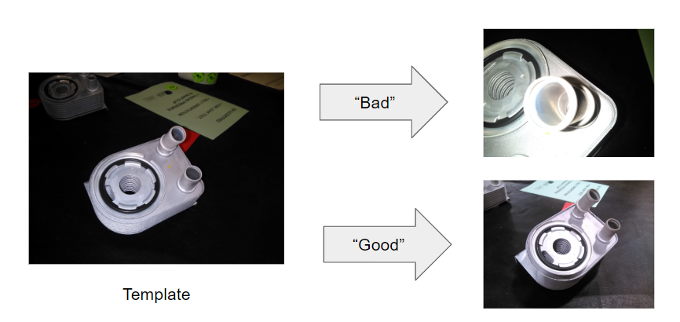
Future Scope
Android Application
Deploy python script to a production environment to be installed on an Android device, such as the Panasonic FZ-X1
ATCO 2019 Project Integration
Merge scripts from both projects to ensure captured images meet acceptable standards before applying the template matching algorithm
Image Database
Create an image database of inspected parts to be used for future Computer Vision projects that include supervised learning models

Slide 30
Lessons Learned

Slide 31
Lessons Learned
Importance of identifying project deliverables and reaching an agreement among all project stakeholders
Sensible & skill-based division of work
Project management & planning
Touch base multiple times a week
Extensive literature review & research

Slide 32
Questions?

Slide 33
Appendix

Slide 34
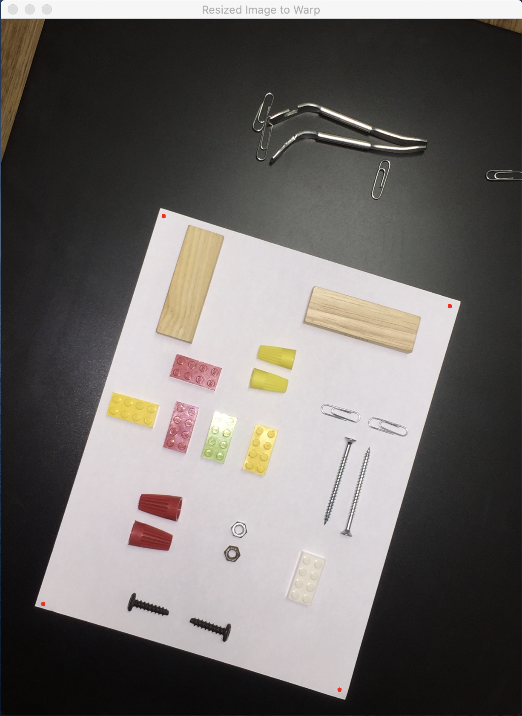
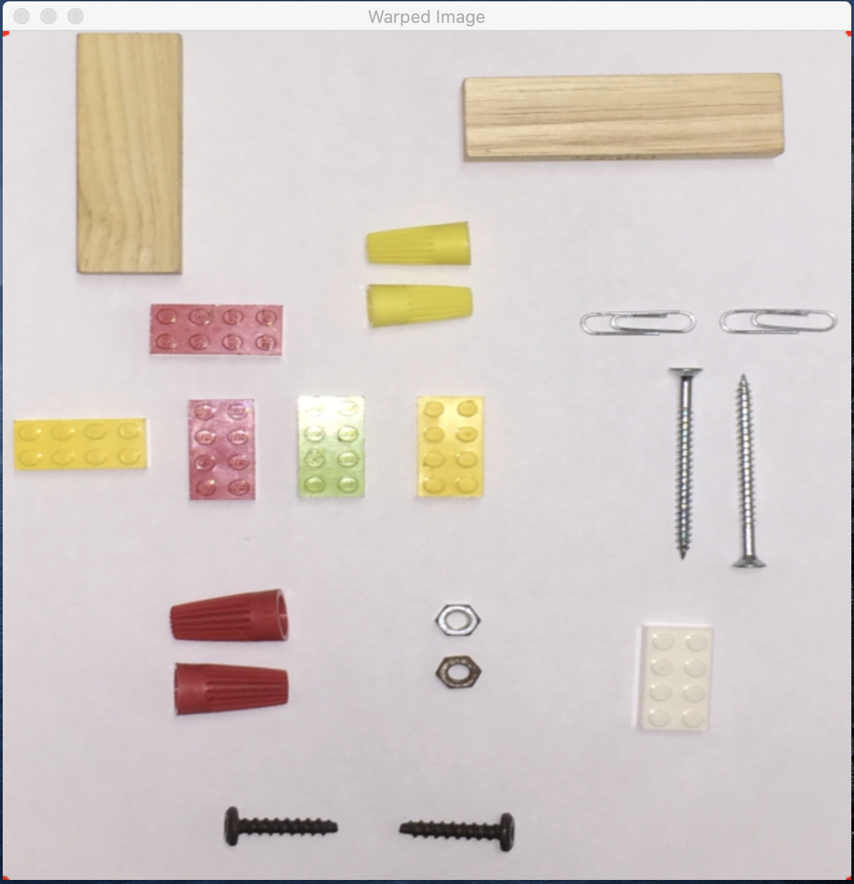
Image Warping
User selects 4 corner points to warp Image
4 points selected making z-pattern
Selected 4 corner points on warped Image

Slide 35
Image Scaling
Diameter = 12
Diameter = 75
Width = 17
Width = 275

Slide 36
Image Scaling (cont’d)

Slide 37
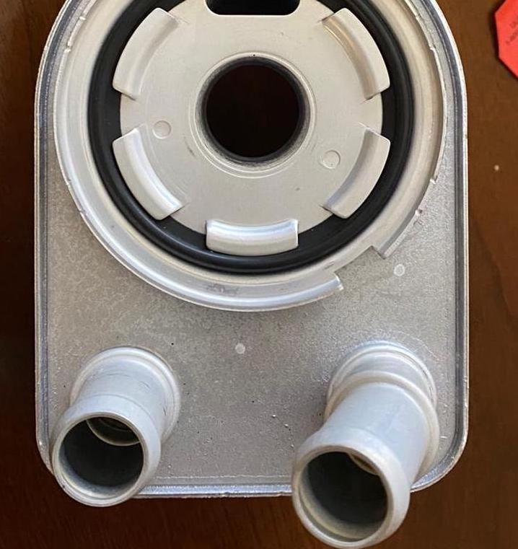
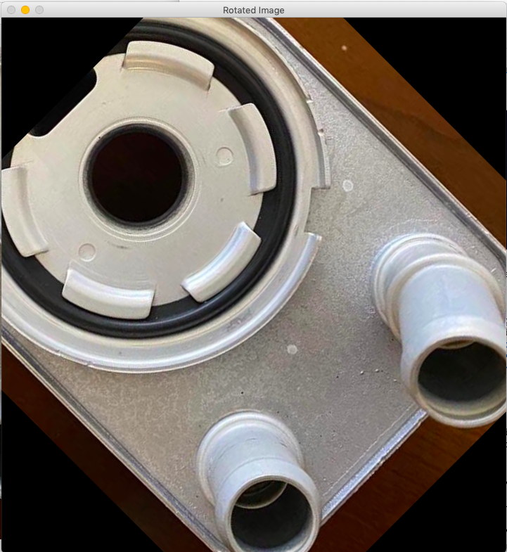
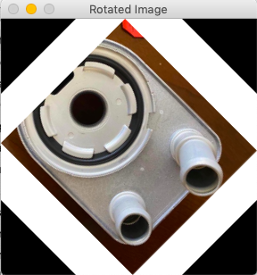
Image Rotation – Padding Effect
Source Image
Rotation W/O Padding
Rotation With Padding

Slide 38
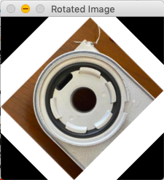
Image Rotation
Padded Source Image
Template
Rotate 45⁰ CCW
(x₀,y₀)
1
2
1
5
4
3
(x₁,y₁)

Slide 39
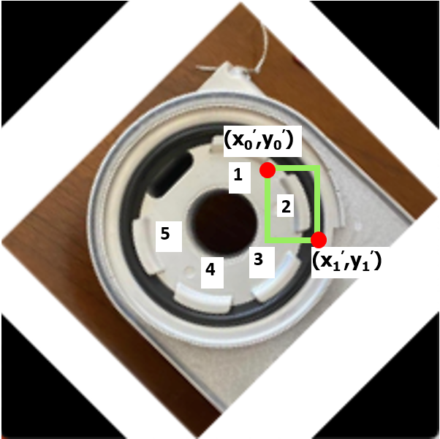
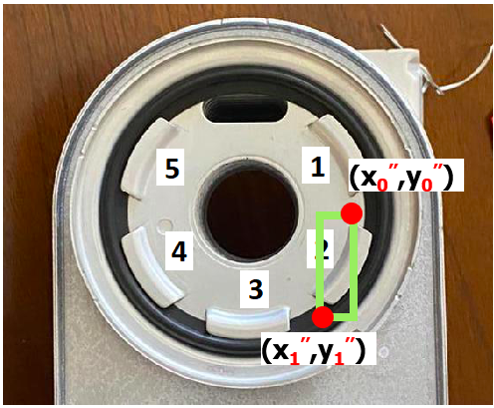
Image Rotation (cont’d)
Rotate +45⁰ CCW
Rotate -45⁰ CW

Slide 40
Image Rotation (cont’d)

